Slide 1
Final Presentation
By Darren Huynh
5/18/2016

Slide 2
I am
22 Years Old
Psychology Major
(Trying) Going to Graduate School for Guidance Counseling and Social Work
Video game fan
Build Computers for friends, experienced in troubleshooting

Slide 3
Computer Science Minor
Reasons why I chose CSCI as a minor:
Genuinely interested in Computer Programming
I had taken enough CSCI courses aside from 232 and 233
More fluent/familiar with higher order programming languages like Ruby, Python, Java than C++, Assembly
Interested in Content Management/Databases
Would like to do Front/Back end web development

Slide 4
Overview of Project
My project is an Inventory Program that allows users to:
Create Entries
Edit Entries
View Entries
Generate a Summary Page
In a user friendly interface. The information is stored in an SQL table, which interacts with Python as its container/integrator.
There is also an “Admin” function, which allows “admin level” usage, which includes deleting entries.

Slide 5
Recap of Goals
Python: Functions to Create Data, Store, Retrieve with exception catches (non-repeating data entries) working properly. Function to grab a computer object and modify it will be included
GUI: Widgets developed, menus, resizing windows and widgets
SQlite: Hierarchical table structure, all data normalized, keys are properly assigned. Many to one relationship network etc.

Slide 6
Goals Met
Python - Data manipulation functions implemented, error handling is mostly complete, admin login/password to prevent arbitrary data modification.
Changelog integrated, records activity, activity type, and time. Changelog is created if it doesn’t already exist in directory.
TKInter - Button widgets are fully functional, GUI is easy to look at and use, things are placed appropriately. Summary page is dynamically created.
SQLite - Database/table is created and/or connected to. Manipulation of the table is fully implemented. This (Computers) table is created if it is missing from the directory as well.

Slide 7
TkInter Usage
GUI application developed using TkInter widgets
Linked Frame “pages”. Buttons show different frames/pages that are preloaded/reloaded dynamically.
Individual “pages” have separate frames that allow easier manipulation of widget placement.
Entry/Label widgets are clear, buttons to interact are in proximity.
Buttons execute functions that interact with SQLite to perform database operations.
Message/Dialog boxes pop up to either verify completion, announce errors, and generally communicate information to user.

Slide 8
SQLite Usage
Database with a table to store information about computers.
SQL commands take user entry via TKInter buttons, and executes table functions, such as Insert (Create Entry), Update (Edit Entry), Select ( View Entry), and Delete (Admin Delete)
Database/Table is created if it does not exist in the active directory.

Slide 9
Python Usage
Program written completely in Python(2.7).
Integration of modules that implement/supplement TKInter and/or SQLite
Tkmessagebox, timesys, date etc
Functions that are called upon button press, and execution of SQL statements are written in Python.
Overall, Python is the mastermind of the program.

Slide 10
Project Demo

Slide 11
Difficulties Expected
Ensuring data normalization
Exception handling
Functions working properly

Slide 12
Difficulties Faced
Using Grid
Learning Grid was a bit tricky, but I got through it
Getting column data from SQLite table
The way that fetchall() works is weird, as it takes an entire row, and splits it into a list
Catching weird exceptions
At first the view entry page only displayed the first computer that matched the query
Summary page used to be loaded statically.

Slide 13
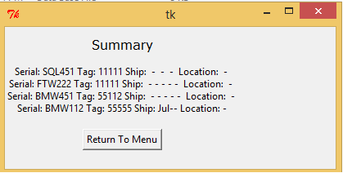
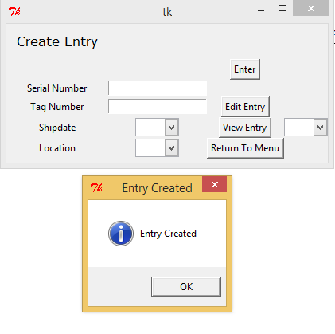
Pictures Old Summary
Before Adding Computer
Created Entry

Slide 14
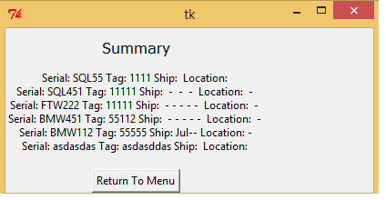
Before Reload
After Reload

Slide 15
Lessons Learned
Grid is superior to Pack for more interactive programs
Pack is useful for simple GUI designs, such as single frame, non-interactive windows.
Grid lets you place everything where you want, and decide sizes of columns etc.
Preloading frames is insufficient for updated “pages/frames”
Preloading frames in a container object will not update dynamically; using TopLevel() allows for easier window creation that displays information that is changed within a program session. Toplevel is also really useful for Tkmessagebox
Error Handling is easier to write as you write functions initially
Didn’t have to backtrack to catch errors as I wrote exceptions and checks earlier

Slide 16
Possible Expansions
Conversion of User input into Object Creation
Enables object manipulation, class functions, inheritance
Instead of grabbing column data, we can grab objects and extract information
Allows for “Ticket” status (Using Checkbox for Error - Boolean Column?)
More advanced GUI management
Sizing of windows/frames is not great, implementation of scrollbars for summary page
More options for summary page generation
Different parameters to filter/order by increases utility IE: Show computers on X floor, or shipdates exceeding certain date etc.

Slide 17
Different Vision/Expansion
Instead of separate pages, reprogram the whole thing as one big window, with items in a listbox that you can select, and then perform a certain action on
Will still have some Toplevel Prompts for interaction.

Slide 18
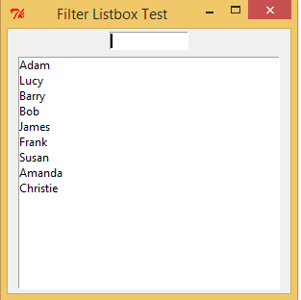
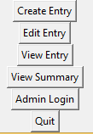
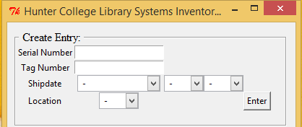

Slide 19
Random Thoughts
Coding buttons/labels for each “page” was incredibly repetitive and is ugly to look at
A lot of code is not “DRY”. It bothers me a lot.
Python is somewhat limited in terms of functionality with/without modules
I had to find modules that allowed for a function that I wanted, IE messagebox required to make “proper” dialog boxes in my opinion.

Slide 20
In Conclusion
Learned a lot about GUI programming (In Python).
Database management is not exactly that fun/clean, but is powerful.

